Slide 1

Elsecar Holy Trinity CE Primary Academy Updated school vision breakfast
Worship Leaders
17th June 2025
Notes:
Welcome to our breakfast meeting to share our school’s updated vision.

Slide 2
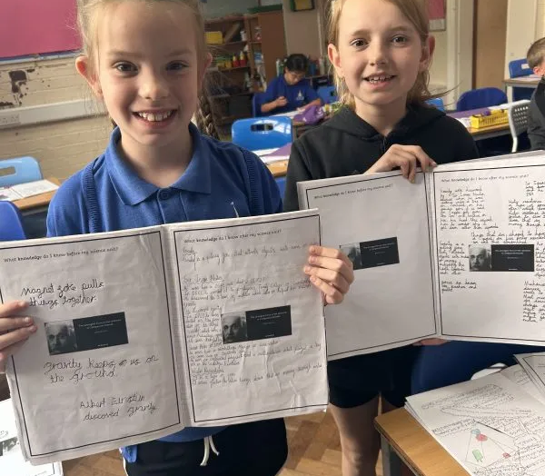
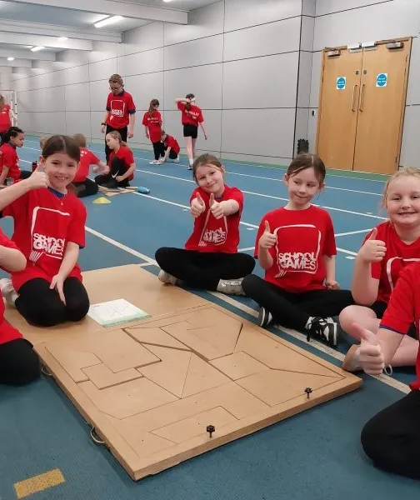
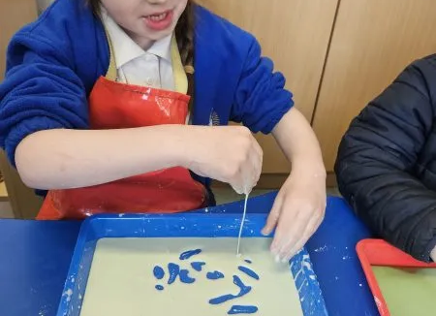
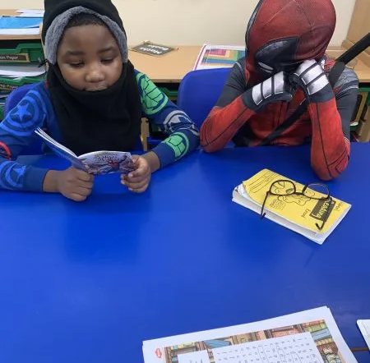
Why does a school need a vision?
An effective school need a vision that is clear, punchy and reflects the ambitions of the whole-school community. Not only should it bring a school together, it should ensure that everyone is moving in the right direction and pulling towards the same goals. With an up-to-date school vision statement, school improvement planning is so much easier and more meaningful.
Notes:
Why does our school need a vision?
Read the reason on the slide.

Slide 3
How we updated our vision?
We asked all stakeholders one simple question!
What does Elsecar School mean to you?
Notes:
How did we make sure everyone in our school community was involved?
Read the slide

Slide 4
We asked… You said…
This is what we think about Elsecar School
friendly | loving | community | caring | history
singing | welcoming | helpful | inclusion | a big heart
prayer | church | Rev Steve | support | family
playtime | hard working |  |  | fun
Notes:
We had responses from governors, staff, family and pupils.
Here are some of the words that people shared with us.
Read the words.

Slide 5
The staff then collated all the different thoughts and feelings given to us and worked hard to put it into a 60 word paragraph, as it had to be concise!
We also asked our Diocese advisor to take a look at our final statement to make sure it was perfect for our school.

Slide 6
We are proud to announce our updated vision statement for June 2025!
Our school, our church, our community
Elsecar Holy Trinity is a nurturing, inclusive, Church school where everyone is valued as a child of God. We warmly welcome people of all faiths/worldviews and backgrounds, fostering respect, compassion and forgiveness. Rooted in faith, family and community, we aim to grow together in love, developing wisdom, knowledge and aspirations for a brighter future.
Notes:
Read the slide

Slide 7

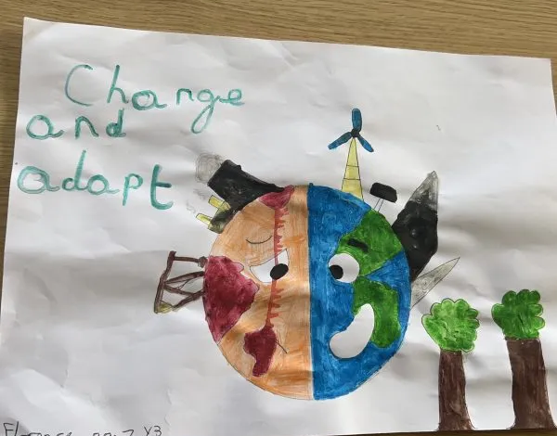
Thank you for attending! Please enjoy a little breakfast.
Notes:
Read the slide Y3 pupils read a sentence each.

